Slide 1
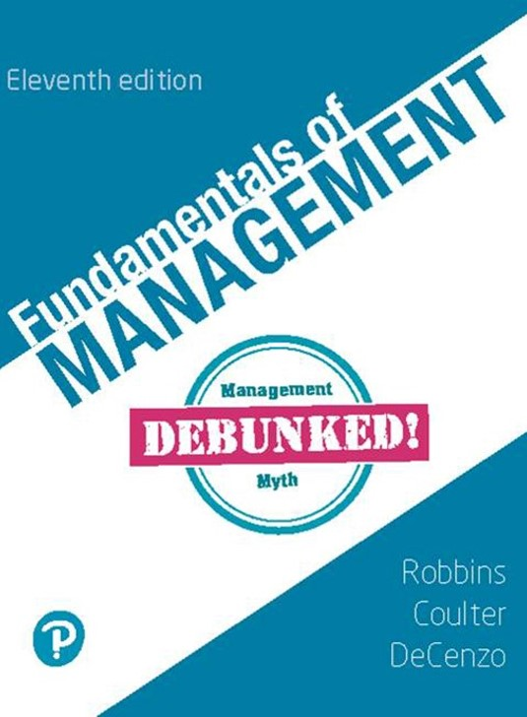
Fundamentals of Management
Eleventh Edition
Chapter 9
Managing Human Resources and Diversity
Copyright © 2020, 2017, 2015 Pearson Education, Inc. All Rights Reserved
Notes:
If this PowerPoint presentation contains mathematical equations, you may need to check that your computer has the following installed:
1) Math Type Plugin
2) Math Player (free versions available)
3) NVDA Reader (free versions available)

Slide 2
Learning Objectives (1 of 2)
9.1 Describe the key components of the human resource management process and the important influences on that process.
9.2 Discuss the tasks associated with identifying and selecting competent employees.
9.3 Explain how employees are provided with needed skills and knowledge.

Slide 3
Learning Objectives (2 of 2)
9.4 Describe strategies for retaining competent, high-performing employees.
9.5 Discuss contemporary issues in managing human resources.
9.6 Explain what workforce diversity and inclusion are and how they affect the HRM process.

Slide 4
Learning Objective 9.1
Describe the key components of the human resource management process and the important influences on that process.

Slide 5
Human Resource Management
The management function concerned with getting, training, motivating, and keeping competent employees.
HRM = Right People, Right Place, Right Time

Slide 6
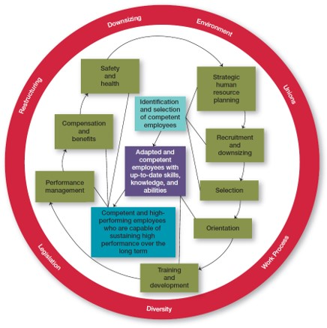
HRM Process and Influences
Exhibit 9.1 The Human Resource Management Process

Slide 7
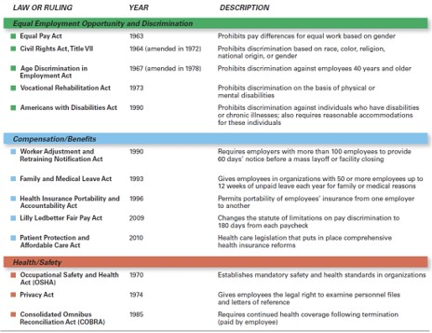
The Legal Environment
Exhibit 9.2 Major H R M Laws
Source: Robbins, Stephen P., Coulter, Mary, Management, 13th E d., © 2016, p. 341. Reprinted and electronically reproduced by permission of Pearson Education, Inc., New York, N Y.

Slide 8
Affirmative Action
Programs that ensure that decisions and practices enhance the employment, upgrading, and retention of members of protected groups.

Slide 9
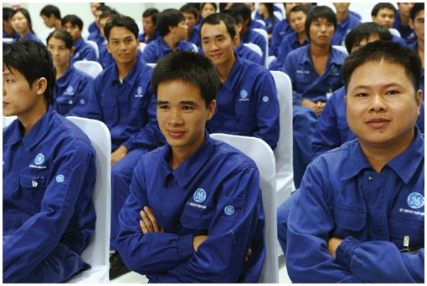
Differences in H R M Laws
Canada
Mexico
Australia
Germany

Slide 10
Learning Objective 9.2
Discuss tasks associated with identifying and selecting competent employees.

Slide 11
Identifying and Selecting Employees
H R M Process:
Employment planning
Recruitment and downsizing
Selection
Supply and Demand aren’t just for economics—they’re
also important to H R M!

Slide 12


Conducting Employee Assessments
How does an organization do a current H R assessment?
Why IS JOB ANALYSIS so important?
Job analysis results in: Job description
describes the job
&
Job specification
describes the person

Slide 13
Determining Future Employment Needs
Demand for human resources (employees) is a result of the demand for the organization’s products or services.
Needed! Outstanding Job Applicants!
Now . . . how do we get those?

Slide 14

Recruiting Applicants
Exhibit 9.3 Recruiting Sources
SOURCE | ADVANTAGES | DISADVANTAGES
Internet/social media | Reaches large numbers of people; can get immediate feedback 92 percent of recruiters use social media when looking for potential candidates super 12 | Generates many unqualified candidates
Employee referrals | Knowledge about the organization provided by current employee; can generate strong candidates because a good referral reflects on the recommender | May not increase the diversity and mix of employees
Company Web site | Wide distribution; can be targeted to specific groups | Generates many unqualified candidates
College recruiting/job fairs | Large centralized body of candidates | Limited to entry-level positions
Professional recruiting organizations | Good knowledge of industry challenges and requirements | Little commitment to specific organization
Source: Robbins, Stephen P., Coulter, Mary, Management, 13th E d., © 2016, p. 346. Reprinted and electronically reproduced by permission of Pearson Education, Inc., New York, N Y.

Slide 15
Handling Layoffs
Exhibit 9.4 Downsizing Options
OPTION | DESCRIPTION
Firing | Permanent involuntary termination
Layoffs | Temporary involuntary termination; may last only a few days or extend to years
Attrition | Not filling openings created by voluntary resignations or normal retirements
Transfers | Moving employees either laterally or downward; usually does not reduce costs but can reduce intraorganizational supply–demand imbalances
Reduced workweeks | Having employees work fewer hours per week, share jobs, or through furloughs perform their jobs on a parttime basis
Early retirements | Providing incentives to older and more-senior employees for retiring before their normal retirement date
Job sharing | Having employees, typically two part-timers, share one full-time position

Slide 16
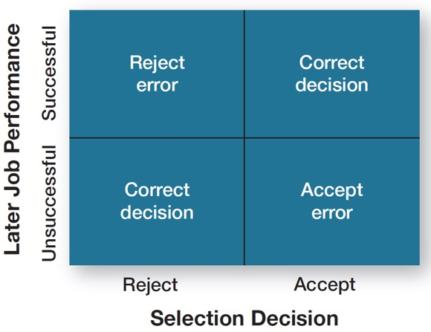
Selecting Job Applicants
Exhibit 9.5 Selection Decision Outcomes

Slide 17

Reliability and Validity
Reliability:
The degree to which a selection device measures the same thing consistently.
Validity:
The proven relationship between a selection device and some relevant criterion.

Slide 18
Selection Devices
How effective are tests and interviews as selection devices?
Tests . . . not just for school!

Slide 19
Effective Interviewing
How Can I Be a Good Interviewer?
TIPS FOR MANAGERS: Make interviews more valid and reliable!
Review the job description and job specification to help in assessing the applicant.
Prepare a structured set of questions to ask all applicants for the job.
Review an applicant’s résumé before meeting him or her.
Ask questions and listen carefully to the applicant’s answer.
Write your evaluation of the applicant while the interview is still fresh in your mind.

Slide 20
Closing the Deal
How can you close the deal?
It’s just as important to retain good people as it is to hire
them in the first place.

Slide 21
Learning Objective 9.3
Explain how employees are provided with the needed skills and knowledge.

Slide 22
Orientation
Job orientation
Work unit orientation
Organization orientation

Slide 23
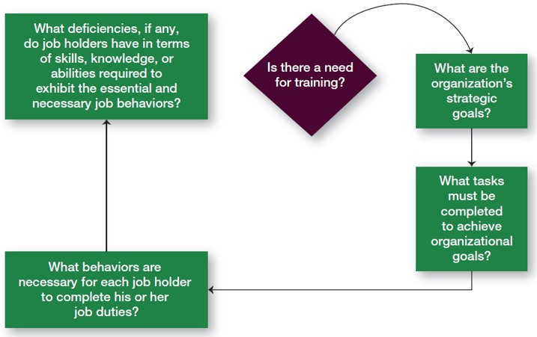
Providing Skills and Knowledge
Exhibit 9.6 Determining Whether Training Is Needed

Slide 24
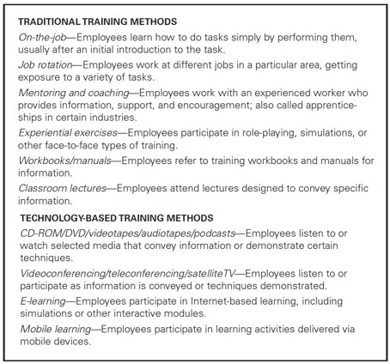
Employee Training Methods
Exhibit 9.7 Training Methods
Source: Robbins, Stephen P., Coulter, Mary, Management, 13th E d., © 2016, p. 353. Reprinted and electronically reproduced by permission of Pearson Education, Inc., New York, N Y.

Slide 25
Learning Objective 9.4
Describe strategies for retaining competent, high-performing employees.

Slide 26


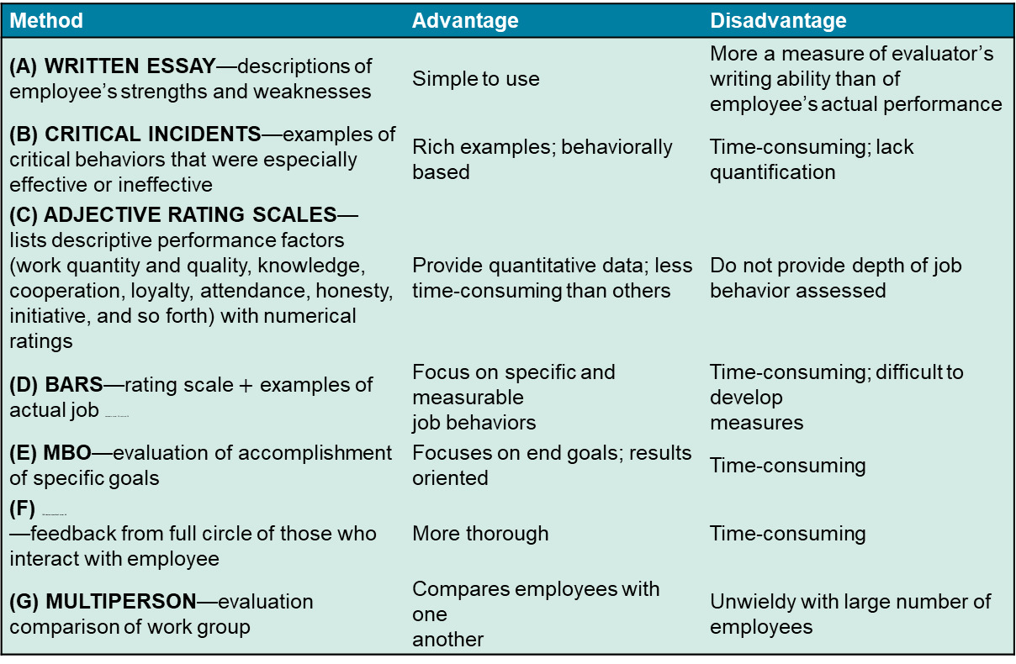
Retaining Competent Employees
Exhibit 9.8 Specific Performance Appraisal Methods
Method | Advantage | Disadvantage
(A) WRITTEN ESSAY—descriptions of employee’s strengths and weaknesses | Simple to use | More a measure of evaluator’s writing ability than of employee’s actual performance
(B) CRITICAL INCIDENTS—examples of critical behaviors that were especially effective or ineffective | Rich examples; behaviorally based | Time-consuming; lack quantification
(C) ADJECTIVE RATING SCALES— lists descriptive performance factors (work quantity and quality, knowledge, cooperation, loyalty, attendance, honesty, initiative, and so forth) with numerical ratings | Provide quantitative data; less time-consuming than others | Do not provide depth of job behavior assessed
(D) BARS—rating scale $+$ examples of actual job behaviors super 38 comma 39 | Focus on specific and measurable job behaviors | Time-consuming; difficult to develop measures
(E) MBO—evaluation of accomplishment of specific goals | Focuses on end goals; results oriented | Time-consuming
(F) 360-degree appraisal super 40 —feedback from full circle of those who interact with employee | More thorough | Time-consuming
(G) MULTIPERSON—evaluation comparison of work group | Compares employees with one another | Unwieldy with large number of employees

Slide 27


Issues with Performance Evaluation Systems
Systems may be outdated due to:
  Downsizing
  Project teams
When an employee’s performance is not up to par

Slide 28
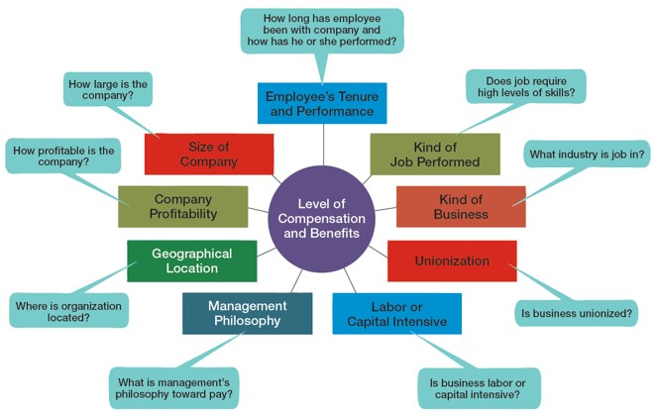
Compensating Employees
Exhibit 9.9 What Determines Pay and Benefits?

Slide 29
Learning Objective 9.5
Discuss contemporary issues in managing human resources.

Slide 30
Managing Downsizing
Exhibit 9.10 Tips for Managing Downsizing
Communicate openly and honestly:
Inform those being let go as soon as possible
Tell surviving employees the new goals and expectations
Explain impact of layoffs
Follow any laws regulating severance pay or benefits
Provide support/counseling for surviving employees
Reassign roles according to individuals’ talents and backgrounds
Focus on boosting morale:
Offer individualized reassurance
Continue to communicate, especially one-on-one
Remain involved and available

Slide 31

Sexual Harassment
Any unwanted action or activity of a sexual nature that explicitly or implicitly affects an individual’s employment, performance, or work environment
Sexual harassment is a serious issue.
48 percent of women report having been sexually, verbally,
or physically harassed at

Slide 32
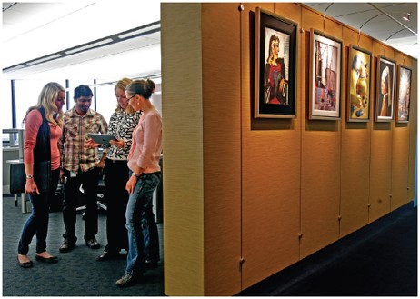
Adapting to a Changing Workforce
Work/life balance programs
Contingent jobs

Slide 33
Learning Objective 9.6
Explain what diversity and inclusion are and how they affect the H R M process.

Slide 34
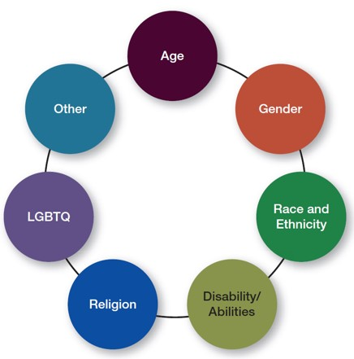
Workforce Diversity
Exhibit 9.11 Types of Diversity Found in Workplaces

Slide 35

Workforce Diversity, Inclusion, and H R M
Achieving workforce diversity and inclusion encompasses such basic H R M activities as recruitment, selection, orientation, training, performance management, and compensation/benefits.

Slide 36

Copyright
This work is protected by United States copyright laws and is provided solely for the use of instructors in teaching their courses and assessing student learning. Dissemination or sale of any part of this work (including on the World Wide Web) will destroy the integrity of the work and is not permitted. The work and materials from it should never be made available to students except by instructors using the accompanying text in their classes. All recipients of this work are expected to abide by these restrictions and to honor the intended pedagogical purposes and the needs of other instructors who rely on these materials.

